Slide 1
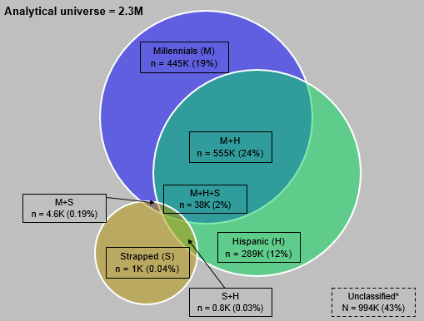
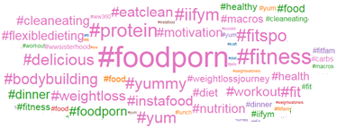
For one of the largest CPG industry, Mu Sigma scoured through the social media data to gain insights around their consumers
Customer Insights- CPG
The explosion in ‘Millennial’ population and consistent growth in ‘Hispanic’ and ‘Strapped’ consumers is posing challenges for clients in decision making around marketing investments*
Client realized that leveraging data through multitude of sources including social media can be a key differentiator to target these evolving segments
Client wanted to understand the attitudes and behavior of these cohorts so that the brand teams can leverage insights in their future marketing strategies and marketing investments
Configured the Hadoop cluster to run advanced analytics and text mining techniques using R to make sense out of the social media data
Collated list of markers to identify the cohorts based on secondary research and inputs from client’s media agencies
Identified the users with high probability of cohort membership
Looked into the hashtags and bigrams to gain insights and identify preferences of the identified cohorts
Client wanted to identify and tag Millennials, Hispanics and Strapped users from the social media in absence of the demographic markers
Client wanted to understand the attitudes and behavior of these to build better marketing strategies in future

